Slide 1

SYMPHONY
BRUSH
GROUP: 07| DES 634

Slide 2

Imagine a world where
every brushstroke on a canvas
creates not just a visual masterpiece,
but also a symphony of sound!

Slide 3

MULTI-SENSORY
ARTISTIC EXPRESSION
The Symphony Brush revolutionizes the
traditional act of painting by infusing it
with dynamic interactive elements that
engage multiple senses simultaneously.
A brush that not only spreads colors across
a canvas but also orchestrates a symphony
of sound and generates mesmerizing
visualizations in real-time.
Welcome to the intersection of art, music,
and technology!

Slide 4

WHAT DOES IT DO?
AUDIO
It is capable of discerning colors. Every shade you select
corresponds to a specific synthesizer sound , creating an
experience where painting becomes a symphonic
endeavour.
The speed at which you paint influences the pitch of the
music, adding a layer of dynamic expression to your
creative process.
VISUAL
A captivating visual representation of sound waves dances
across a screen, evolving in tandem with your brush
strokes. This real-time feedback not only enhances artistic
journey but also deepens your connection to the
immersive sensory world you're crafting.

Slide 5

ACCESSIBLE ART FOR ALL ABILITIES
The interactive nature of the Electronic Paint Brush makes it accessible to individuals of all
ages and abilities, including those with physical disabilities or limited artistic skills. It
provides a platform for creative expression without barriers, fostering inclusivity in the arts.
TARGET USERS
VISUALLY
AUTISTIC
OTHER
IMPAIRED
INDIVIDUALS
DIFFERENTLY ABLED
Audio descriptions of colors
offers an alternative sensory
experience.
Regulate sensory experiences
and develop coping strategies.
Facilitate group painting
Provide opportunities for individuals of
all abilities to engage in creative
expression. Skill development and
therapy for individuals with motor
impairments..
By associating colors with
sounds, blind individuals can
engage in a unique way
sessions to encourage social
interaction and collaboration.
ow and start painting

Slide 6
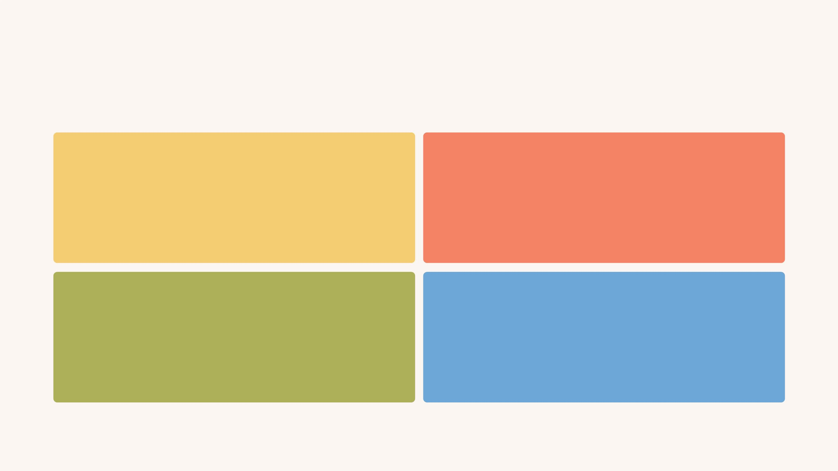
APPLICATIONS
ART THERAPY
EDUCATION &
‘STEAM’ LEARNING
Beneficial for individuals with disabilities,
sensory processing disorders, or mental health
challenges, providing a therapeutic outlet for
self-expression and sensory integration.
Enhances STEAM education by integrating art,
music, and technology, fostering
interdisciplinary learning and creativity.
CREATIVE EXPRESSION
ENTERTAINMENT
Artists could express themselves in new
ways, and audiences could experience art
in a multi-sensory fashion, enhancing
their connection to the piece.
Adds a unique and interactive
element to entertainment venues,
festivals, and cultural events,
captivating audiences of all ages.

Slide 7

USAGE SPECTRUM
Interactive Art Installations
Therapeutic Art Therapy
Educational Tools
Performance Art
Accessible Art for All Abilities
Collaborative Projects
Productivity and Stress Relief

Slide 8
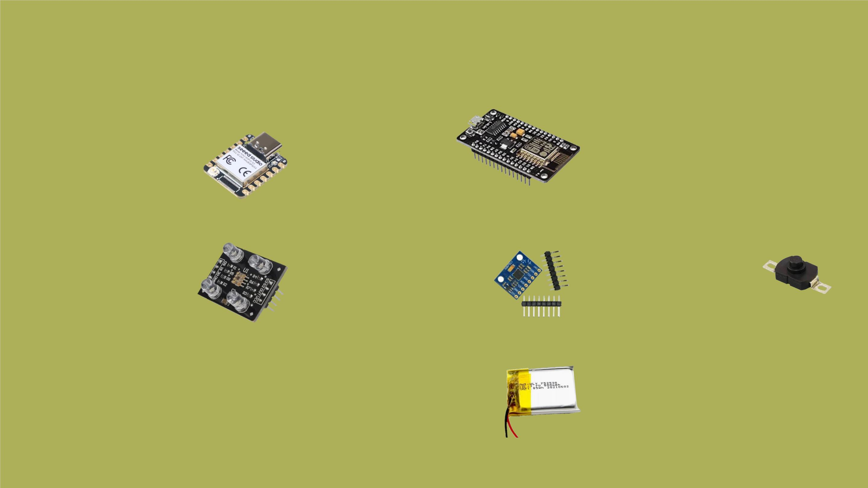
ELECTRONIC COMPONENTS
MIRCROCONTROLLER
Seeed Studio XIAO
ESP32S3 – 2.4GHz
WiFi, BLE 5.0
NODEMCU -
ESP8266 Wifi
Development Board
SENSORS
SWITCH
Electrobot TCS3200
TCS230 Color
Sensor Module
IMU- MPU-6050 3-
Axis Accelerometer
and Gyro Sensor
On-Off button -
Torch Flashlight
Push Switch ON-
OFF - PBS-09
ACTUATOR (softwares)
POWER
Speakers getting
output from:
4.2V Lithium Ion
battery
Touch Designer
Ableton

Slide 9

FORM IDEATION
Color Sensor
Paint brush features a unique design where the
color sensor is positioned akin to an eraser on a
pencil. This placement optimizes usability, allowing
users to effortlessly detect colors simply by hovering
the sensor over the desired colour and pushing the
button.
On/ Off Button
Casing
With this intuitive form factor, users can seamlessly
transition between painting strokes and color
selection, enhancing the fluidity and efficiency of
the creative process.
Detachable Module
Tapered Edge for better grip
Additionally, the sensor's elevated position ensures
minimal interference with the brush's bristles,
preserving the tactile experience of traditional
painting.
Bristles
SIZE: 2.5 CM X 25CM

Slide 10
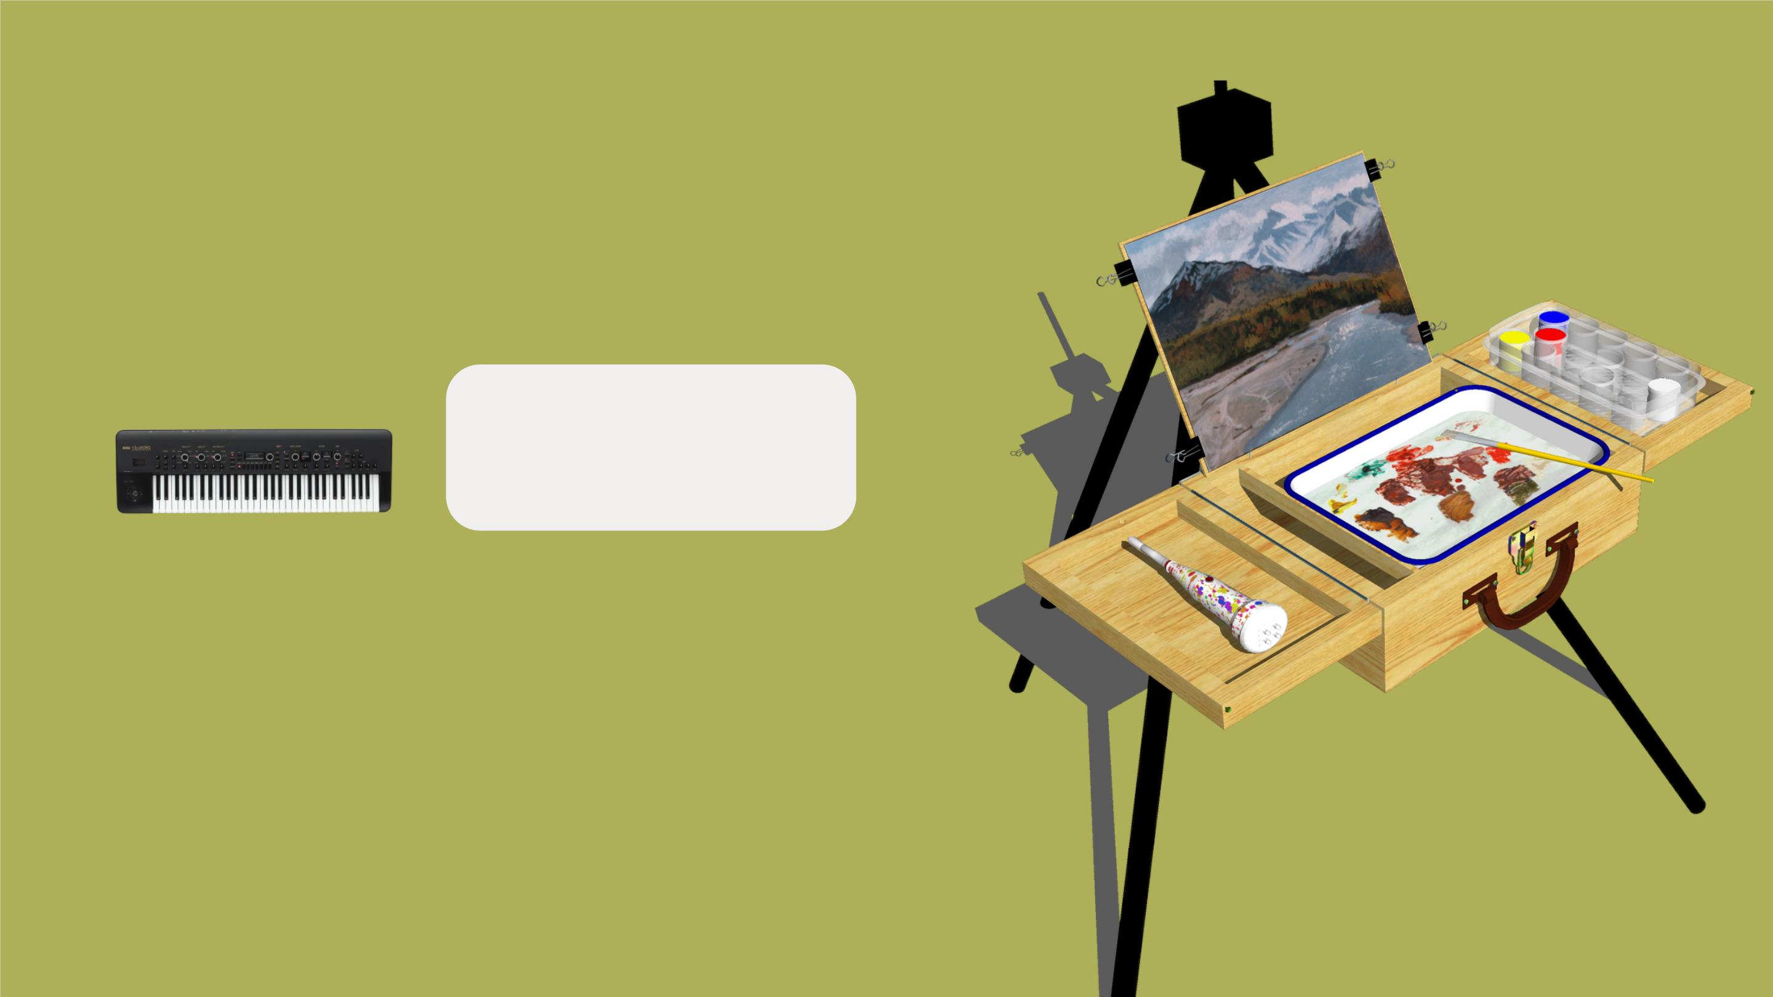
COLOR DETECTION AND
MUSICAL ASSOCIATION
Each color is associated with a specific musical synth. This
association adds a layer of synesthesia, where colors evoke
auditory sensations.
Red: Synth 1
Green: Synth 2
Blue: Synth 3
White: All Combined
SPEED SENSITIVITY AND
& PITCH CONTROL
IMU Sensor detects the stroke speed and Touch Designer
receives values through WIFI, feeds the data to Ableton which
simulates audio and feeds data back to Touch Designer, and
an audio-visual simulation is generated.
Enjoy the visuals coordinated with your hand movement.

Slide 11
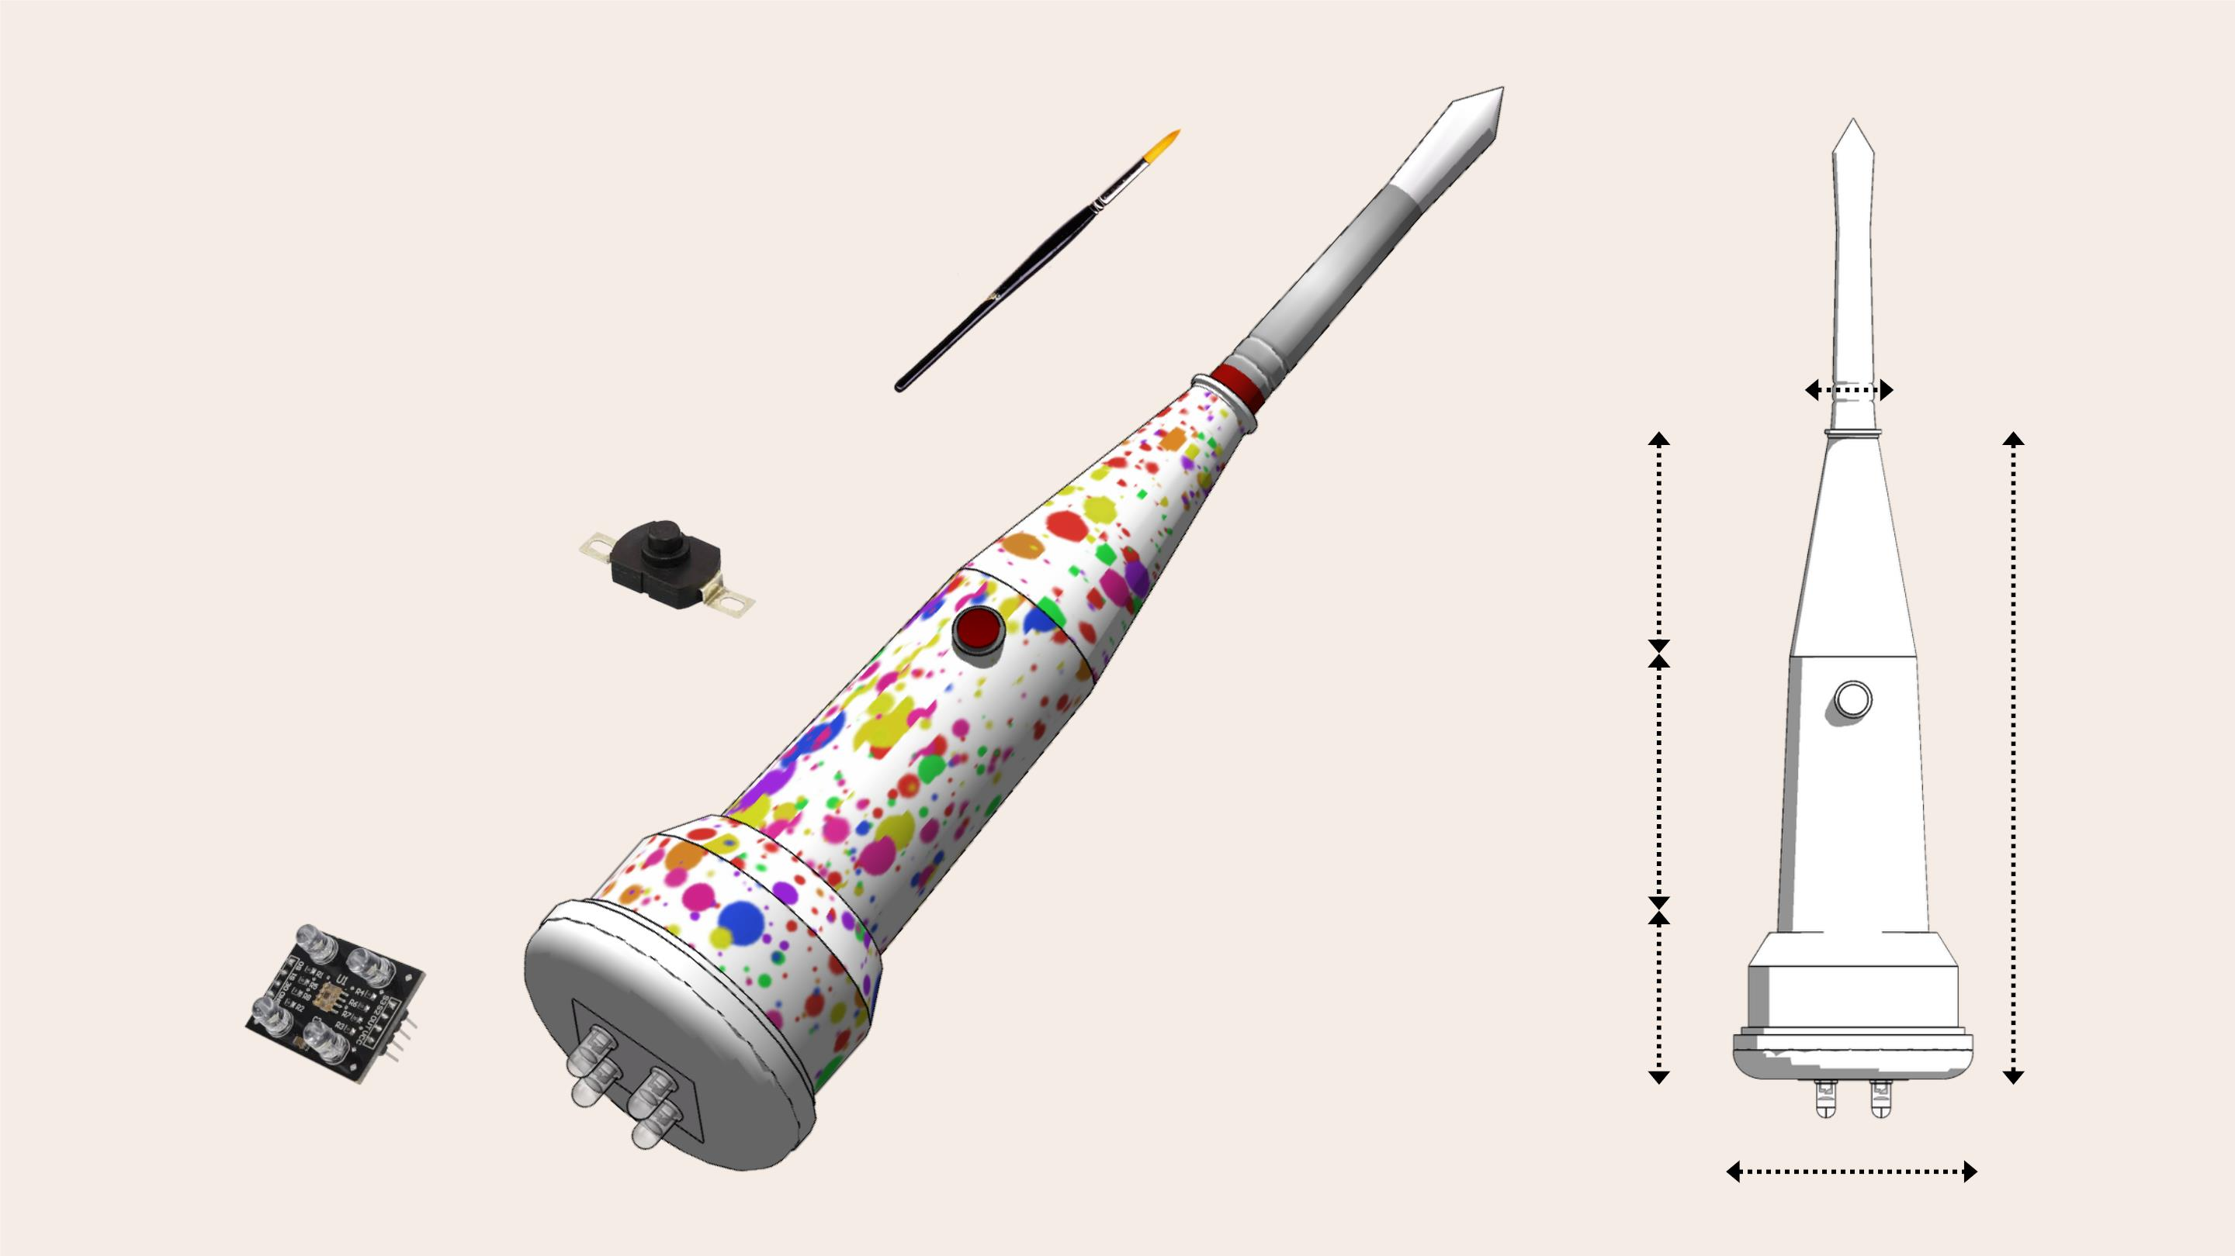
3D MODEL
Form is adaptable
too kinds of standard
artist paintbrushes!
10mm
On-Off button -
Torch Flashlight
Push Switch ON-
OFF - PBS-09
90mm
100mm
60mm
250mm
Electrobot TCS3200
TCS230 Color
Sensor Module
25mm

Slide 12

HOW DO WE USE IT?
PRESS DIP
PAINT ENGAGE
Hold the pen upside
down and point it to
the color you want to
paint with and press
the button
Dip the paint brush
in the same color
now and start
painting
As you start painting,
the instrument/ synth
matched with the
Visual and audio output
expands the possibilities for
creative expression, immersive
experiences, and cross-modal
exploration, making the brush a
versatile tool if you are an artist,
educator, therapist, performer....
respective color/synth
will play. The pitch will
depend on the speed of
your brush strokes.
Color sensor detects
the color

Slide 13
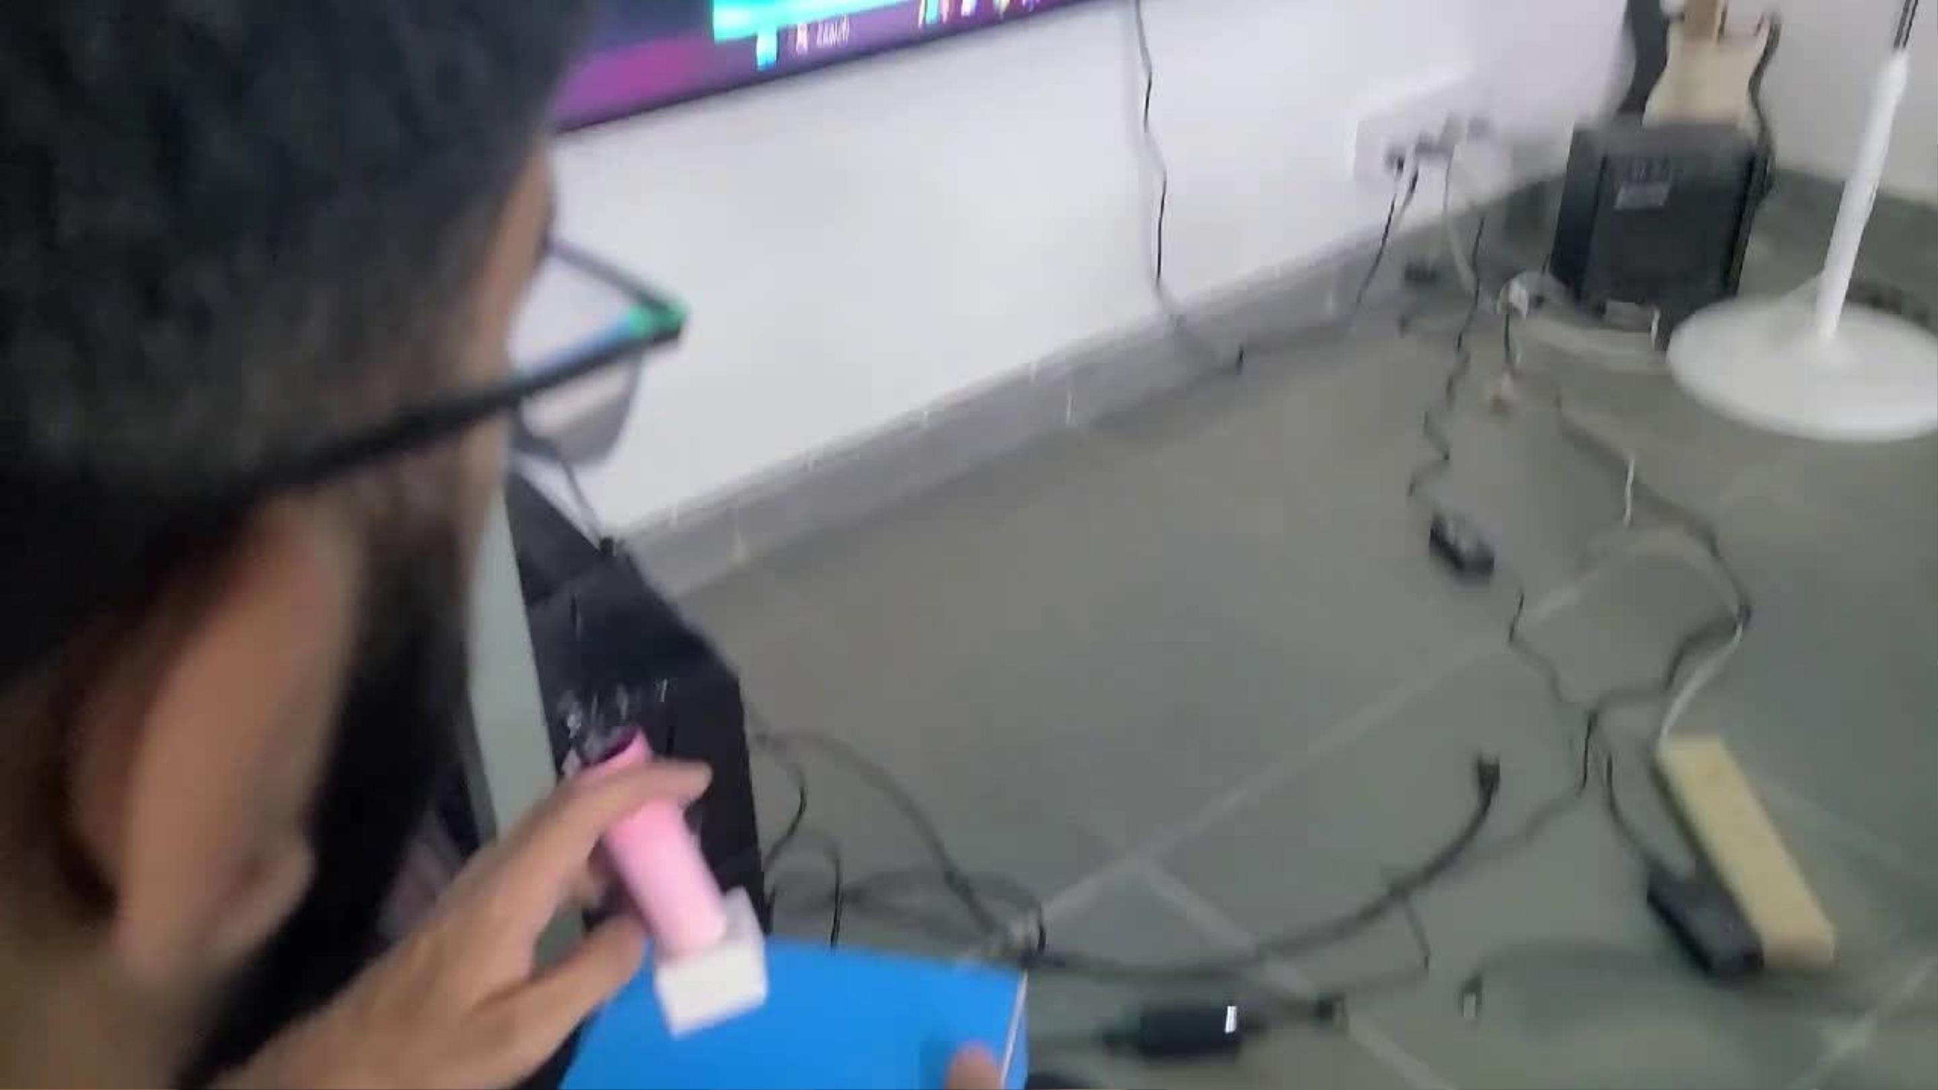
COLOUR SENSOR - FOR DIFFERENT HUES
AFFECTING CHANGING SYNTH STYLE

Slide 14
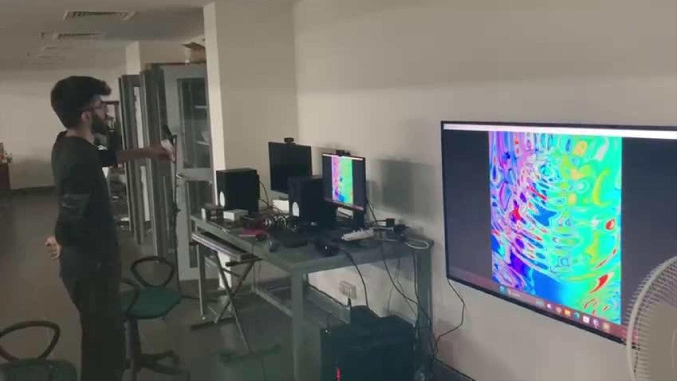
STROKE SPEED AND MOVEMENT
AFFECTING AUDIO VISUAL OUTPUT

Slide 15
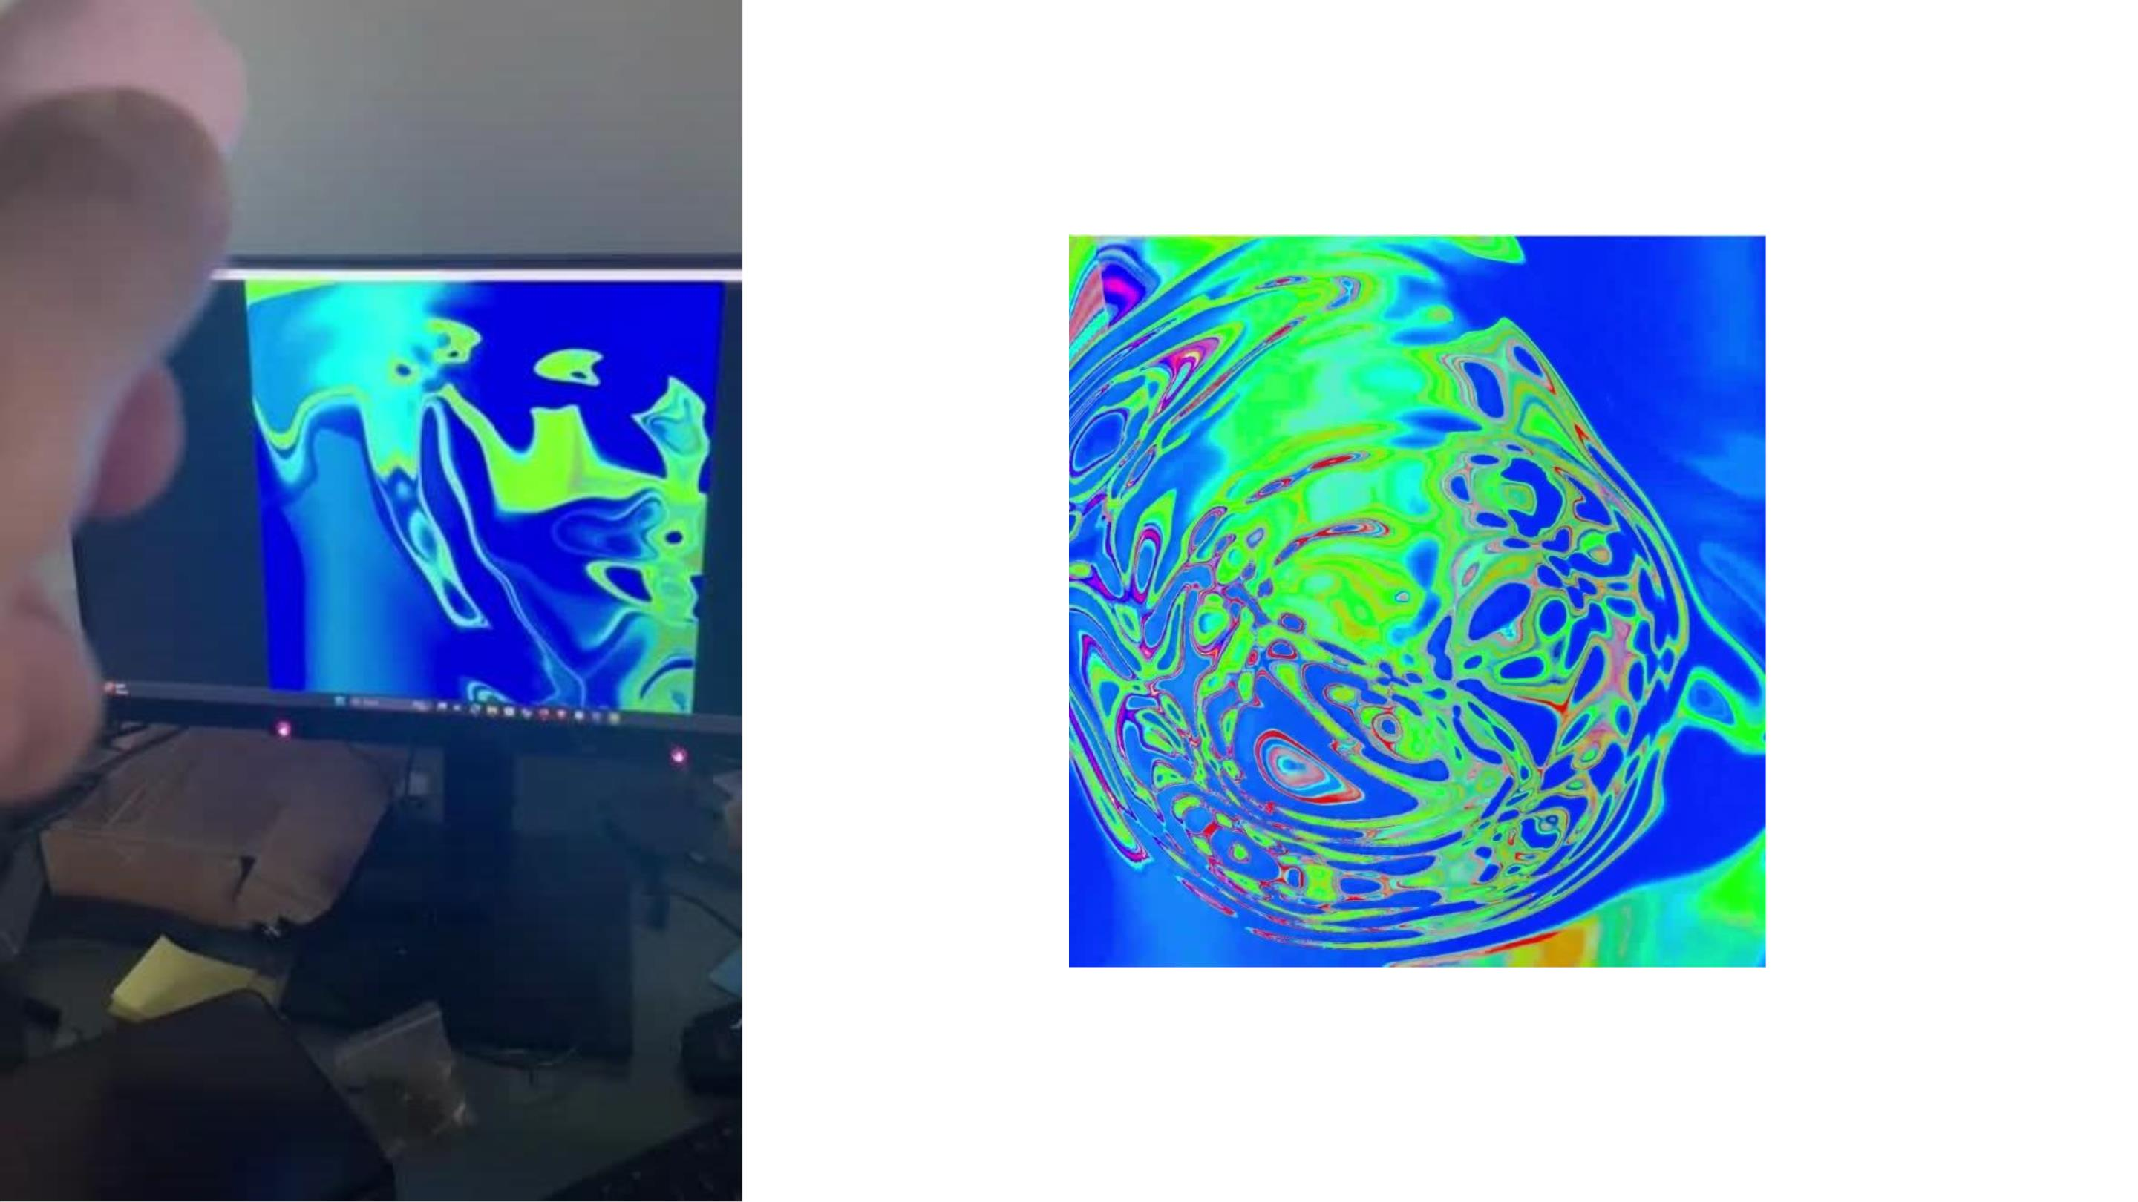
SOUND WAVE RENDER
PITCH VARIATION

Slide 16
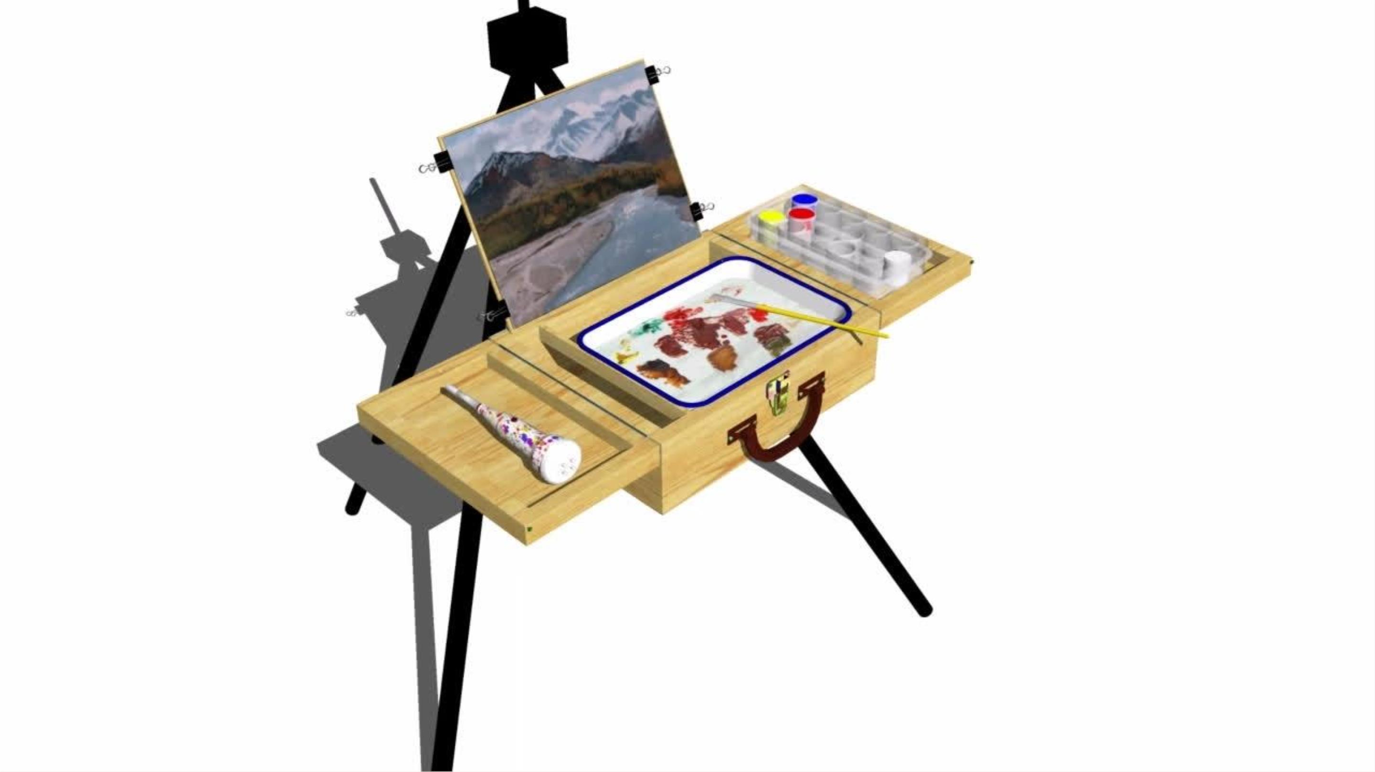
RENDER
PLAY VIDEO

Slide 17
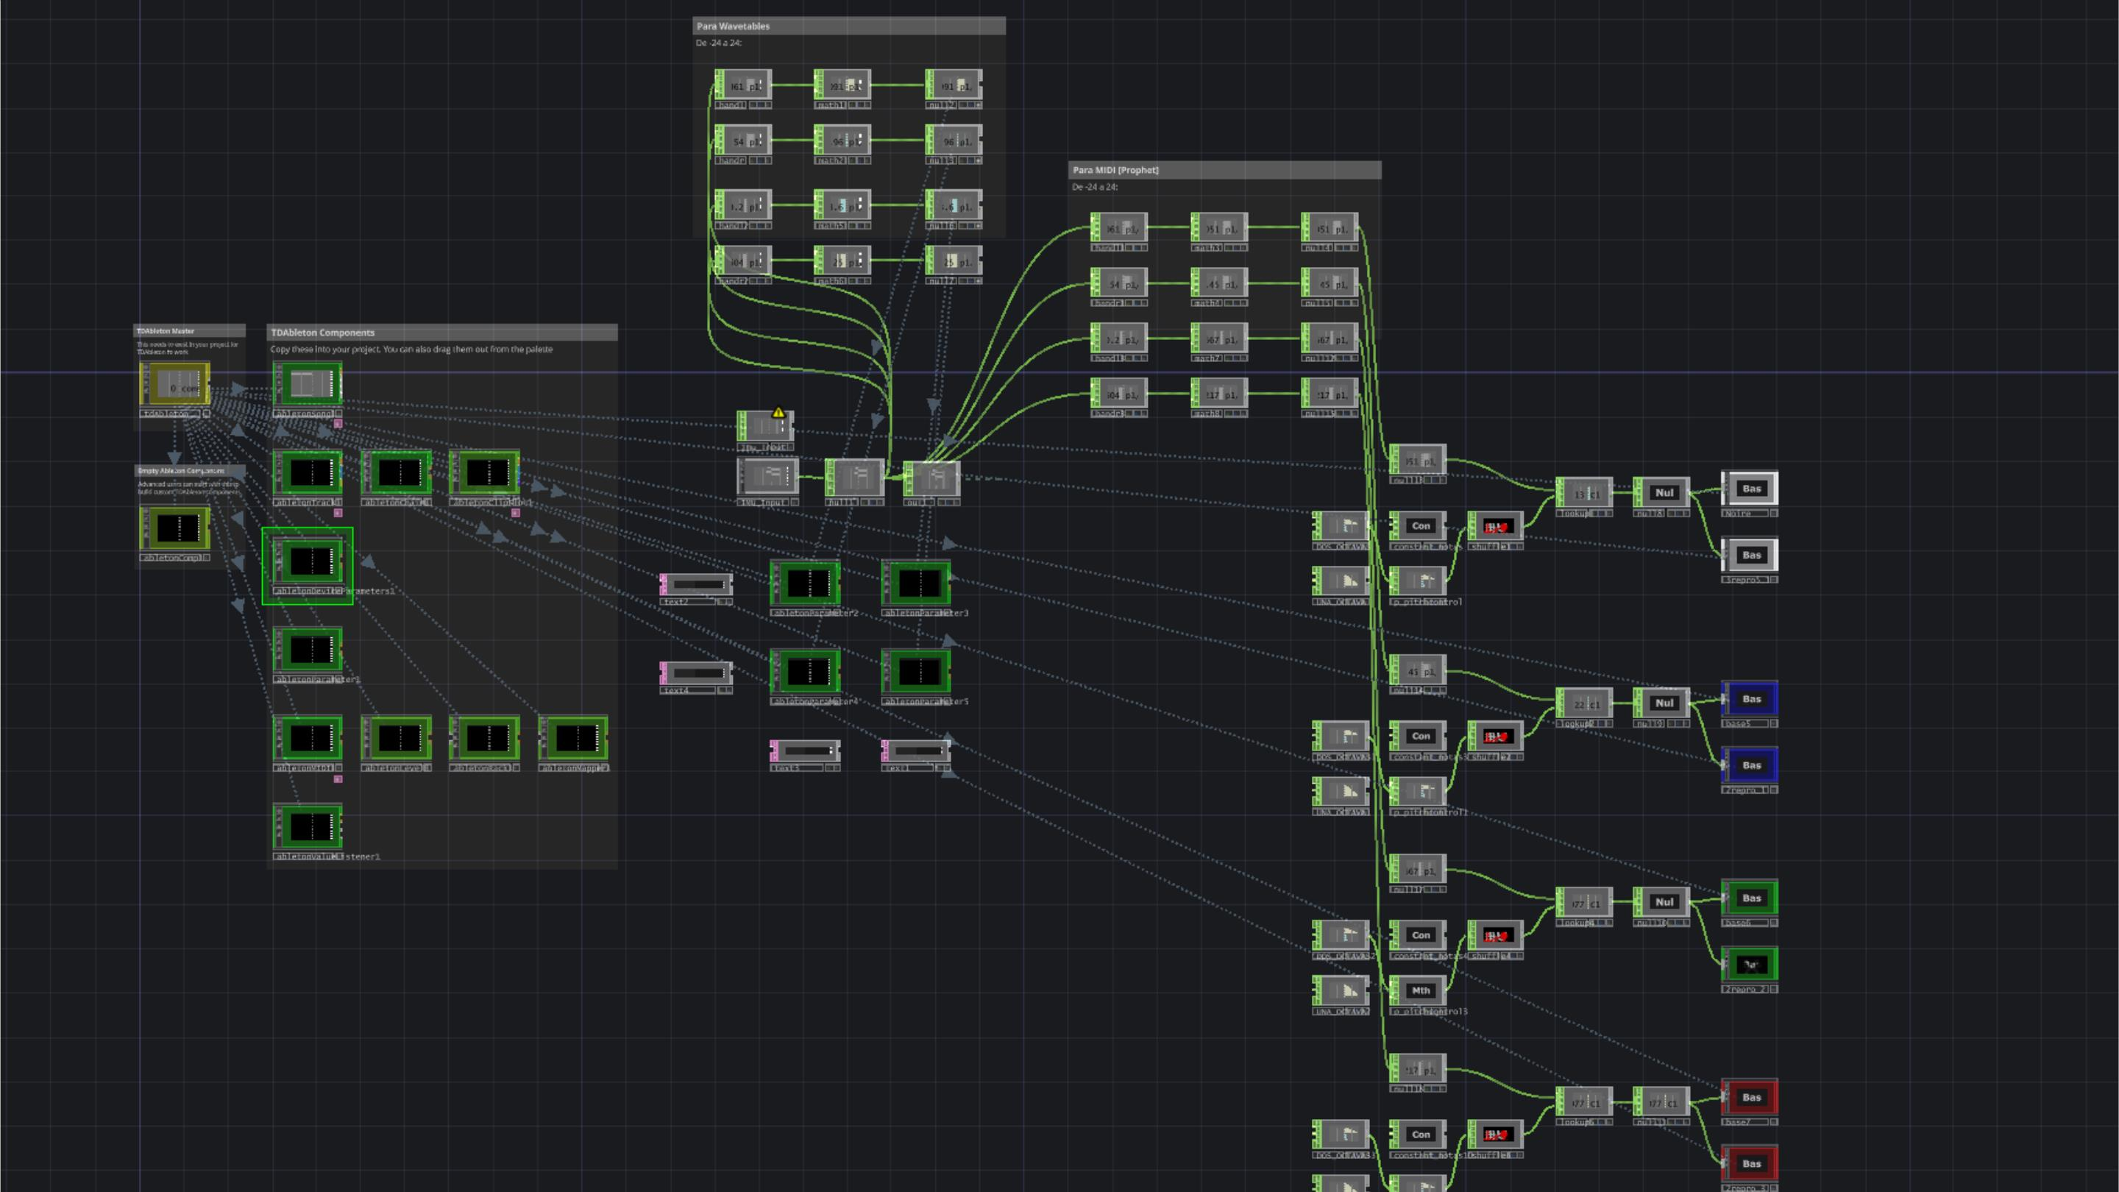
TOUCH DESIGNER
AUDIO TREE

Slide 18
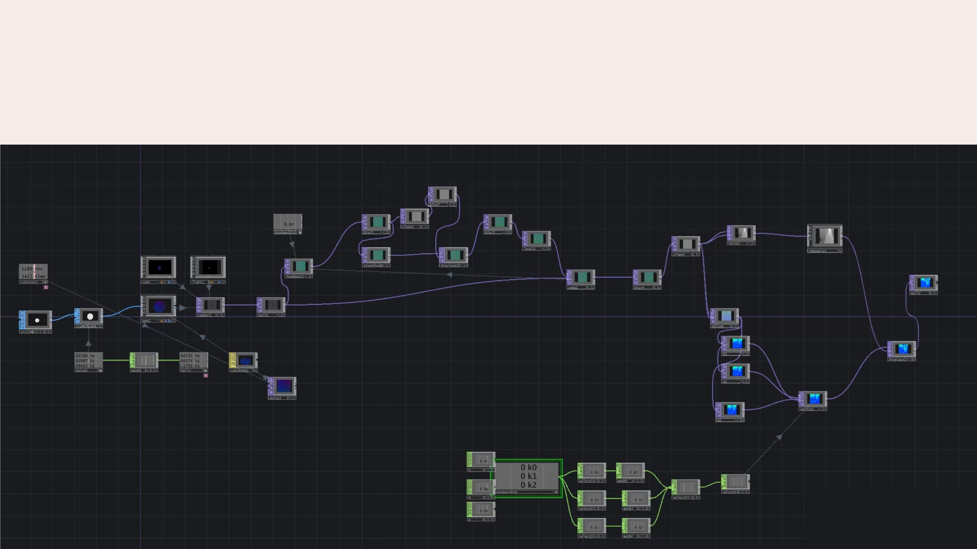
TOUCH DESIGNER: VISUAL NODE TREE
VISUAL SIMULATION OF SOUND WAVES

Slide 19

LINK TO VIEW
FULLCODE*
*This is the code to be run on ESP8266, it receive sensor readings from
xiaoEsp32S3 through wifi and manipulate them and display over Serial Monitor
so that these values can be used by our actuator, i.e, Software Ableton

Slide 20

THANK YOU VERY MUCH!
LET’S KEEP INNOVATING FOR A BETTER FUTURE!

